Slide 1
Updating Windows and Office in 6 Minutes of Touch Time #OSDBuilder #OSDUpdate
https://www.osdeploy.com
@SeguraOSD

Slide 2
About
20+ years Enterprise Experience
OS Deployment Specialist at Baker Hughes, a GE Company
Leo
Presented at HASMUG, CTSMUG, DFWSMUG, and ExpertsLiveUS (2018)
Not a Microsoft MVP

Slide 3
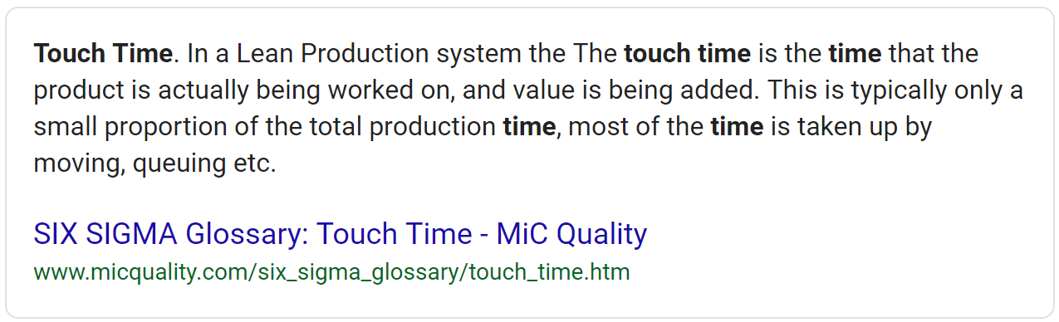
What is Touch Time?

Slide 4
The Six Minutes of Touch Time
Install PowerShell Modules
Install-Module OSDBuilder & Install-Module OSDUpdate
OSDBuilder
Import and Update Windows 10 Offline
OSDUpdate
Update Microsoft Office 2016
Download Microsoft Office 365

Slide 5
OSDBuilder
PowerShell Module
Update and Windows and Server (Update-OSMedia)
Windows 7 and 10
Server 2012 R2, 2016, and 2019
Windows Updates (SSU, LCU, Adobe, DotNet, Dynamic)
Customize Windows and Server (New-OSBuild)
Remove Appx Provisioned Packages, Features, Capabilities
Add Language Packages (LP, LIP, LangFOD)
More +++++++++++++++++++++++++++++++++++

Slide 6
OSDBuilder Import and Update Windows 10 1809 Demo
In 1 Minute of Touch Time

Slide 7
The Updates
Both PowerShell Modules include a “mini” Microsoft Update Database in XML (PowerShell CLIXML)
Database contains Microsoft download links and compatibility information

Slide 8
OSDCatalog
PowerShell Module
Method for exporting Microsoft Update details from WSUS
Used in OSDBuilder and OSDUpdate PowerShell Modules

Slide 9
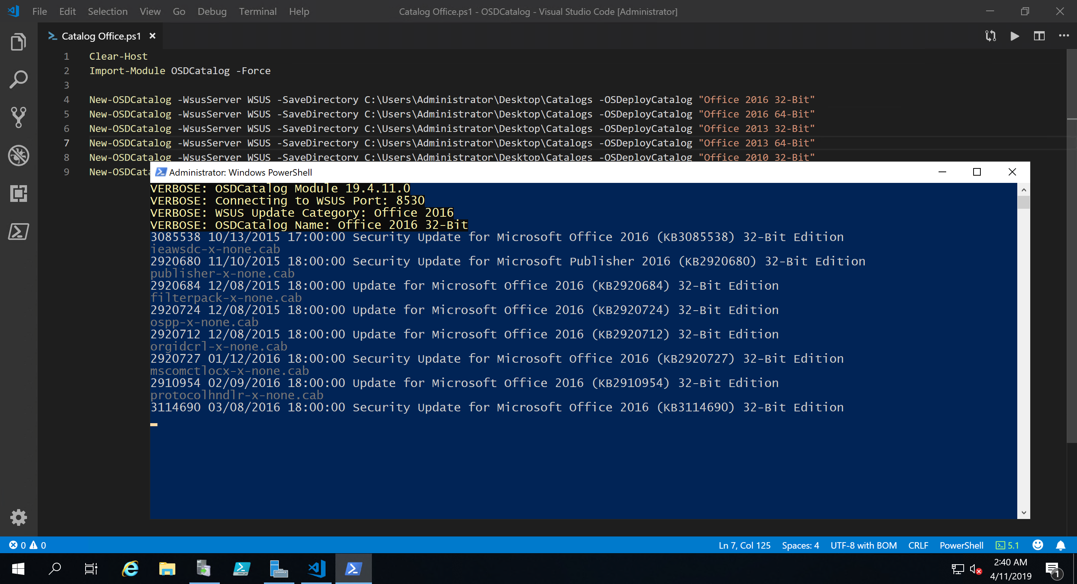

Slide 10
OSDUpdate
PowerShell Module to download Updates
Windows Defender
McAfee DAT
Office 365 and Office 2019 (Insiders, Monthly, SAC, SACT)
Office Updates (2010, 2013, 2016)
Replaces CollectUpdates.vbs
Windows Updates (SSU, LCU, Adobe, DotNet, Dynamic)
Windows 7 and 10
Server 2012 R2, 2016, and 2019

Slide 11
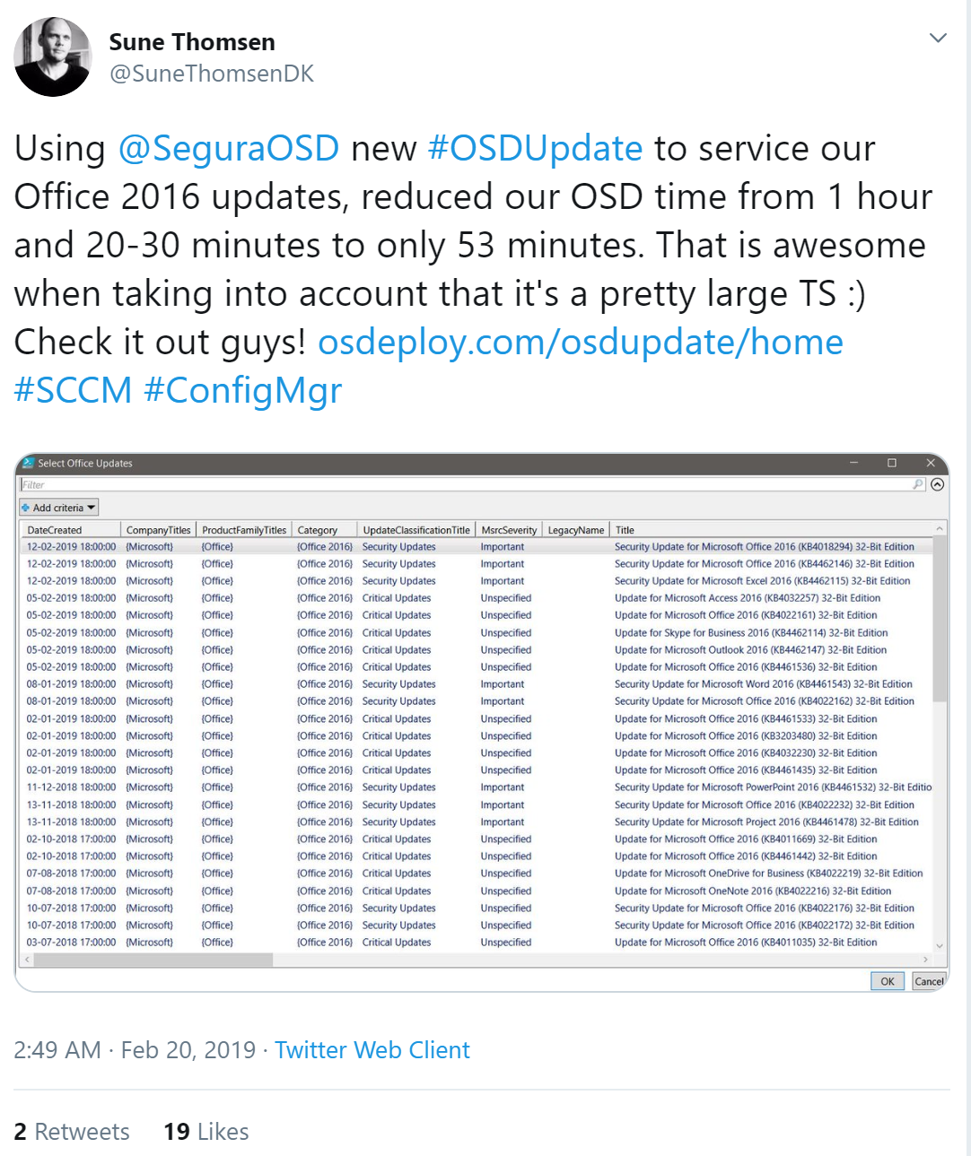

Slide 12
OSDUpdate Office 2016 and Office 365 Demo
In 2 Minutes of Touch Time

Slide 13
OSDUpdate Windows and Office
Stand Alone (USB, Network Share , Disconnected)
SCCM OSD Task Sequence
MDT Task Sequence

Slide 14
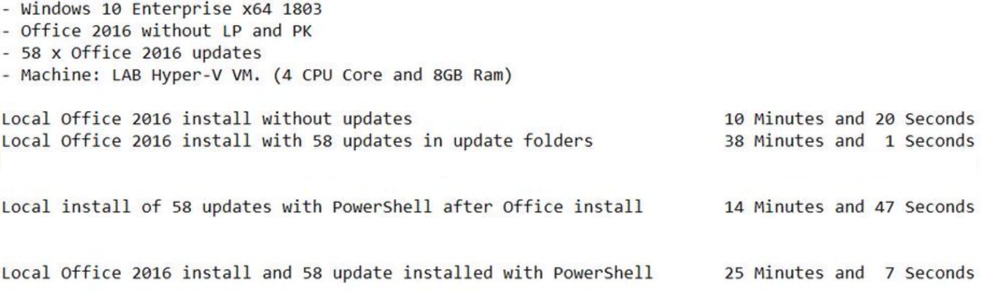

Slide 15
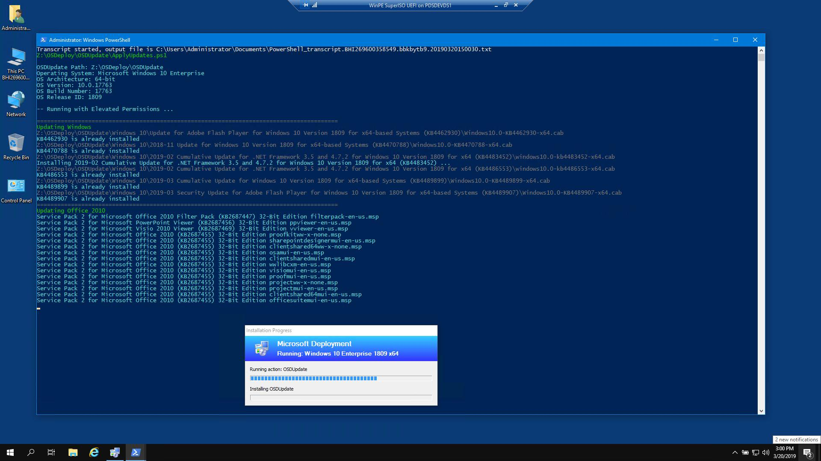

Slide 16
OSDeploy’s PowerShell Modules
PowerShell Gallery
https://www.powershellgallery.com/packages/OSDBuilder
Install-Module –Name OSDBuilder
https://www.powershellgallery.com/packages/OSDUpdate
Install-Module –Name OSDUpdate
https://www.osdeploy.com/

Slide 17
OSDBuilder Windows MultiLang Demo
http://osdbuilder.com/docs/guides/windows-multilang

Slide 18
Q and A
https://www.osdeploy.com/

Slide 19
Thank You HASMUG, Microsoft and the Sponsors!
https://www.osdeploy.com/

